Slide 1
Basic Statistics for Data Science
Aksadur Rahman
aksadur@yahoo.com

Slide 2
Agenda
What Is Statistics?
What Is Data Science?
Qualitative Data
Quantitative Data
Frequency Distribution
Data Presentation
Bar Diagram
Histogram
Pie Chart
Central Tendency
Mean
Median
Mode
Measures of Dispersion
Variance
Standard Deviation

Slide 3
Why is basic statistical knowledge required
in Data Science?

Slide 4
What Is Statistics?
Statistics is a branch of applied mathematics that involves the collection, description, analysis, and inference of conclusions from quantitative data.
What Is Data Science?
Data science is the domain of study that deals with vast volumes of data using modern tools and techniques to find unseen patterns, derive meaningful information, and make business decisions.

Slide 5
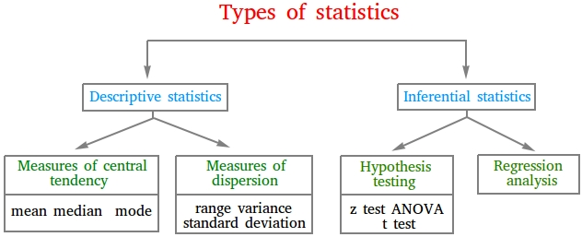

Slide 6
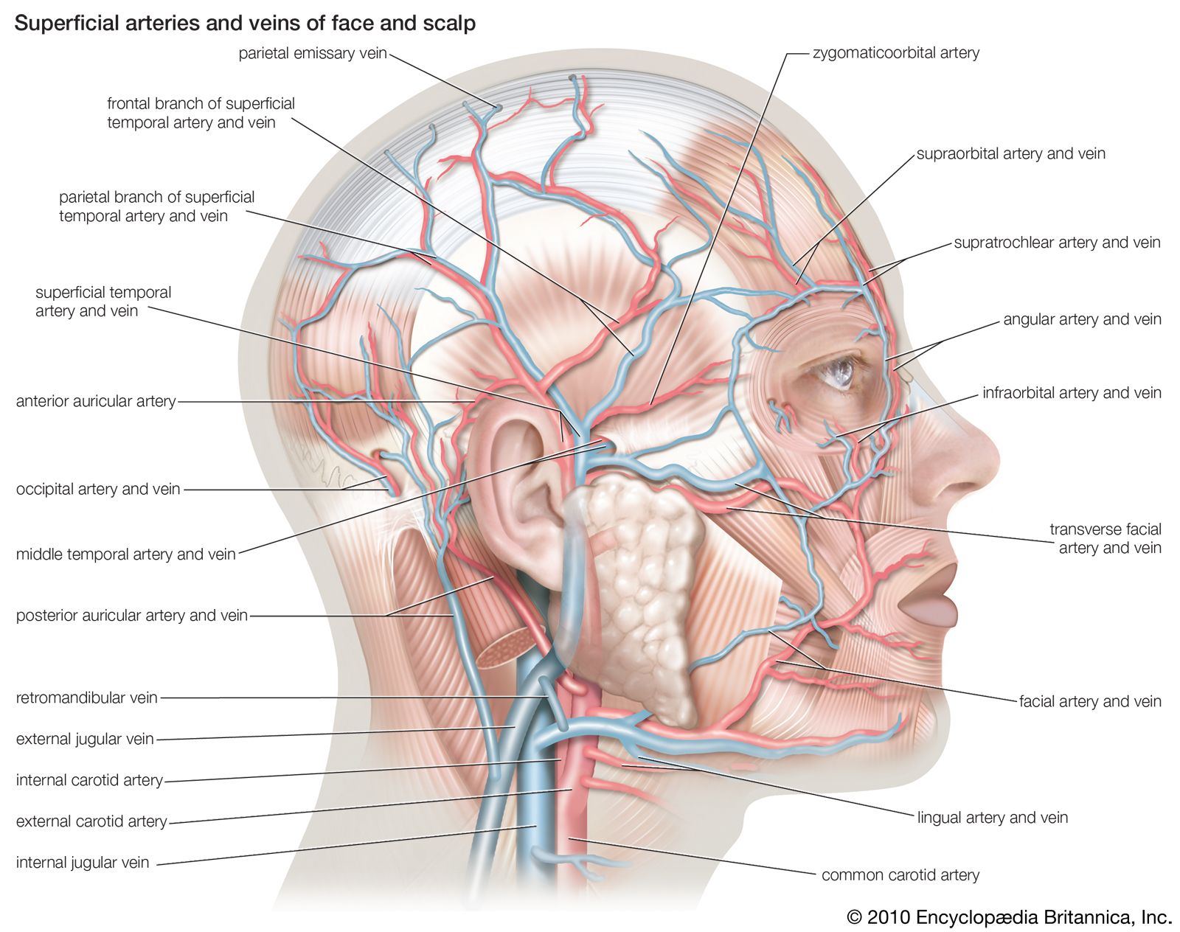
Anatomy of human head

Slide 7
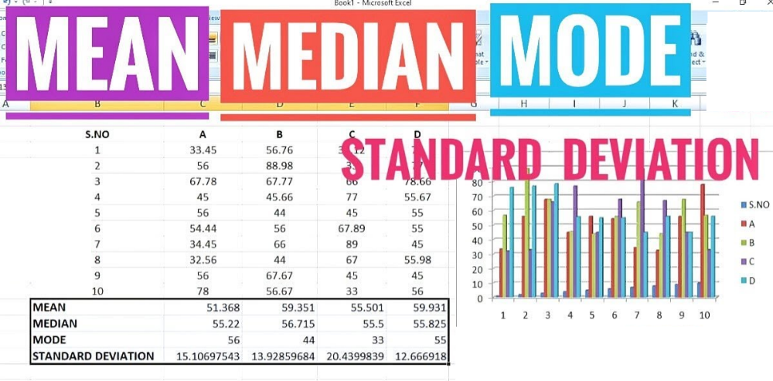
Anatomy of Data

Slide 8
Qualitative Data
Qualitative data is information that cannot be counted, measured or easily expressed using numbers. It is collected from text, audio and images
Quantitative Data
Quantitative data refers to any information that can be quantified, counted or measured, and given a numerical value.

Slide 9
Frequency Distribution
Consider a data set of 26 children of ages 1-6 years. Then the frequency distribution of variable ‘age’ can be tabulated as follows:
Frequency Distribution of Age
Age | 1 | 2 | 3 | 4 | 5 | 6
Frequency | 5 | 3 | 7 | 5 | 4 | 2
Grouped Frequency Distribution of Age:
Age Group | 1-2 | 3-4 | 5-6
Frequency | 8 | 12 | 6

Slide 10
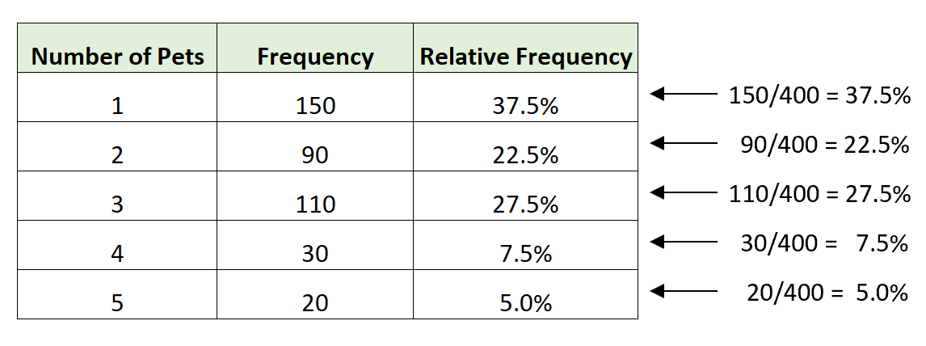
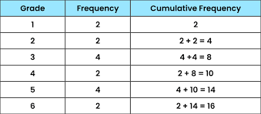
Relative Frequency
Cumulative Frequency

Slide 11
Data Presentation
Two types of statistical presentation of data - graphical and numerical.
Graphical Presentation: We look for the overall pattern and for striking deviations from that pattern. Over all pattern usually described by shape, center, and spread of the data. An individual value that falls outside the overall pattern is called an outlier.
Bar diagram and Pie charts are used for categorical variables.
Histogram, Box-plot are used for numerical variable.

Slide 12
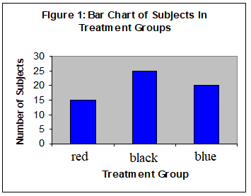
Data Presentation –Categorical Variable
Bar Diagram: A bar diagram (or a bar graph) is a rectangular bar shaped statistical graphic which is divided into several bar to illustrate numerical proportion.
.
Treatment Group | Frequency
red | 15
black | 25
blue | 20
Total | 60

Slide 13
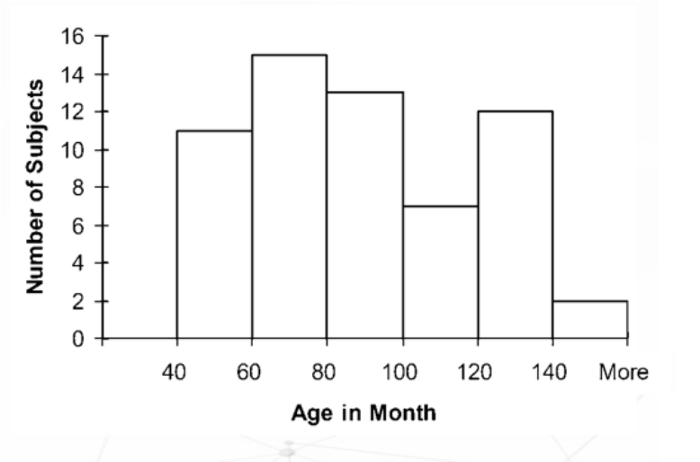
Graphical Presentation –Numerical Variable
Histogram is a graphical representation of the distribution of numerical data. Overall pattern can be described by its shape, center, and spread. The following age distribution is right skewed. The center lies between 80 to 100. No outliers.
Age | Frequency
40-60 | 11
60-80 | 15
80-100 | 13
100-120 | 7
120-140 | 12
More | 2

Slide 14
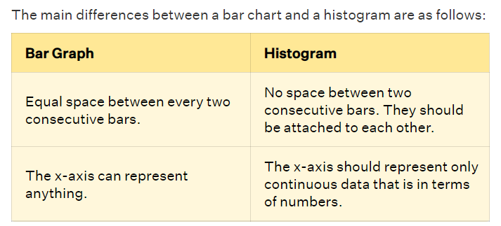
Bar Graph vs Histogram

Slide 15
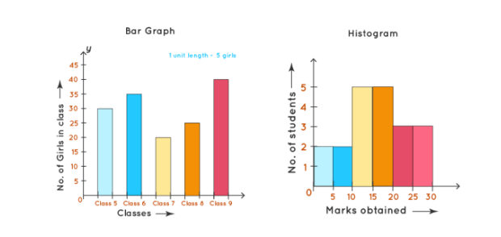
Bar Graph vs Histogram

Slide 16
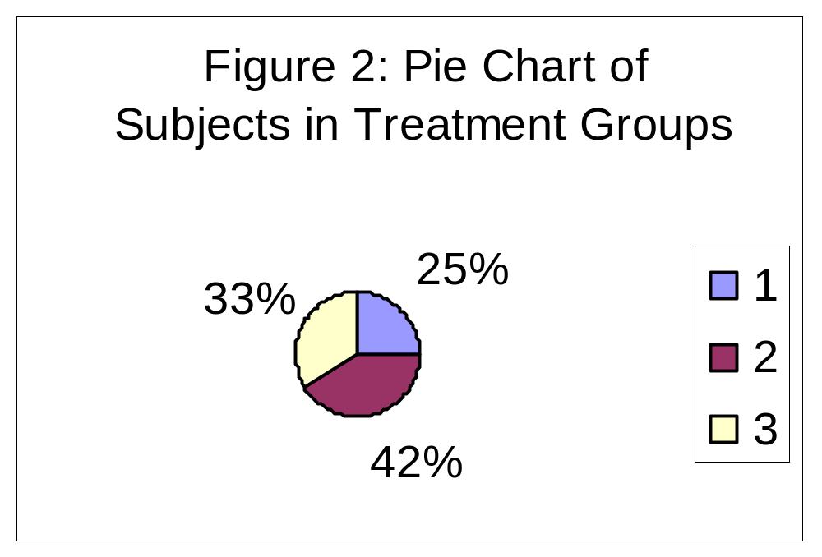
Data Presentation –Categorical Variable
Pie Chart: A pie chart (or a circle chart) is a circular statistical graphic which is divided into slices to illustrate numerical proportion.
Treatment Group | Frequency | Proportion | Percent (%)
1 | 15 | (15/60)=0.25 | 25.0
2 | 25 | (25/60)=0.417 | 41.7
3 | 20 | (20/60)=0.333 | 33.3
Total | 60 | 1.00 | 100

Slide 17
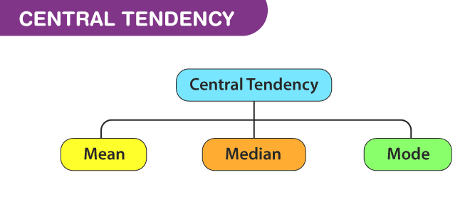
Central Tendency
Central tendency is defined as “the statistical measure that identifies a single value as representative of an entire distribution or sample.

Slide 18
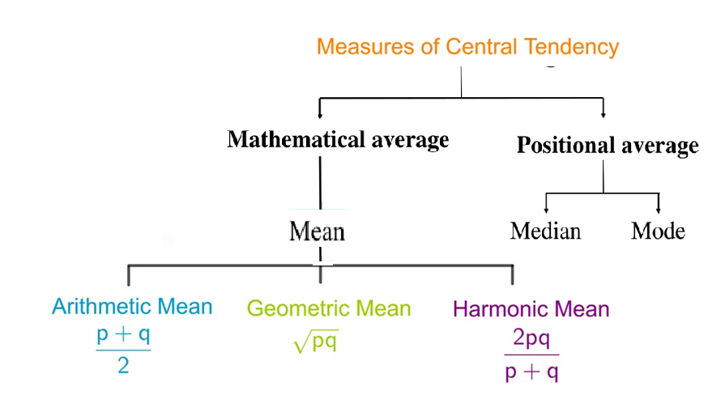
Central Tendency

Slide 19
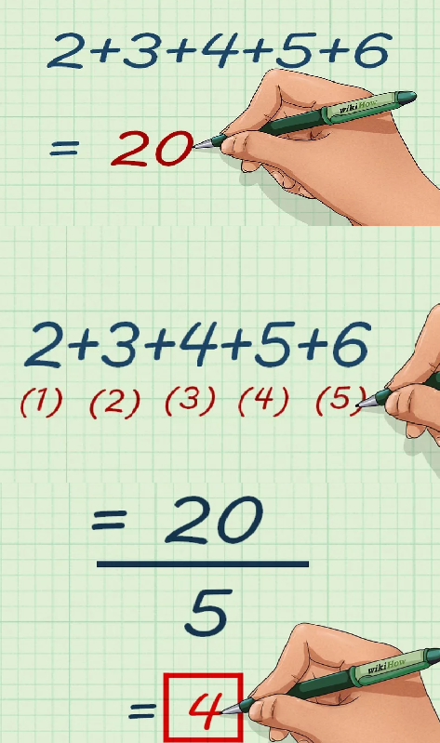
Mean (গড়)
The mean is the mathematical average of a set of two or more numbers.

Slide 20
Mean
Use:
To know the overall result
To determine the skewness and standard deviation
To determine T-Score, Z-Score
Merits:
Easy to determine
Observation has equal weightage
Most reliable Central Tendency

Slide 21
Mean
Limitations:
Value of mean will be changed even of one data is changed
Mean can not be determined if data is qualitative
Mean is affected by extreme score (Outlier)
It cannot be computed accurately if any item is missing
It can not be calculated graphically

Slide 22
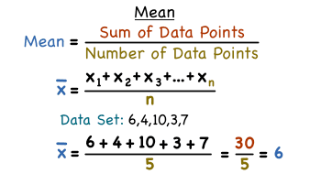
Mean

Slide 23
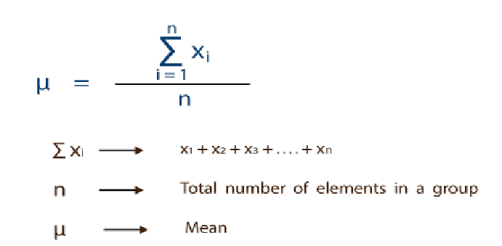
Mean

Slide 24
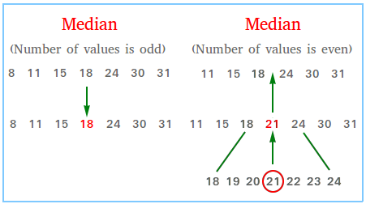
Median(মধ্যমা/মধ্যক)
The median is the value that's exactly in the middle of a dataset when it is ordered. It's a measure of central tendency that separates the lowest 50% from the highest 50% of values.

Slide 25
Median
Use
When we want to know the exact mid point
When the distribution is skewed.
To find skewness
When the distribution contains outliers.
Also it can be used for the qualitative value
Merits
It is not at all affected by extreme values (Outliers)
Median can be determined even any data is missing
It can be located graphically
It is easily understood and is easy to calculate. In some cases it can be located merely by inspection.

Slide 26
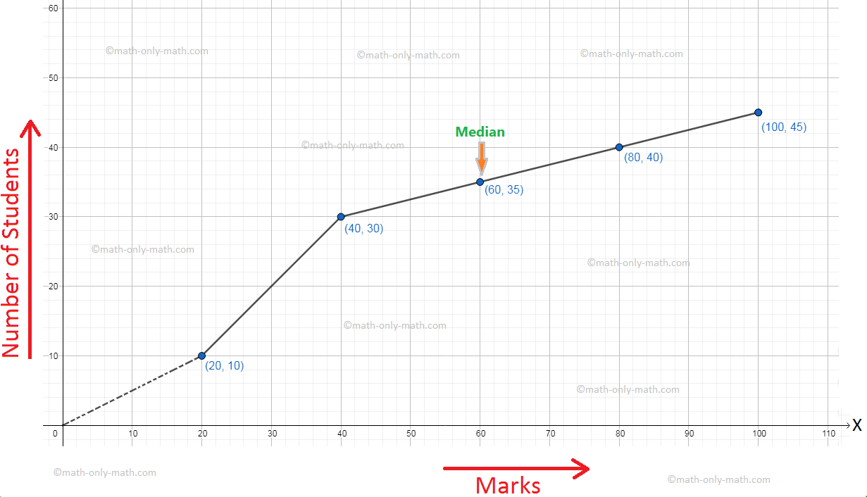
Median (মধ্যমা/মধ্যক)
Median can be located graphically

Slide 27
Median
Limitations:
While calculating median, all the data should be arranged in ascending or in descending order. In case of large number of items, it becomes tedious and time consuming.
Median provides correct result in case of odd observation. When the number is observation is even it fails to obtain accurate result.
It does not use all the data/score

Slide 28
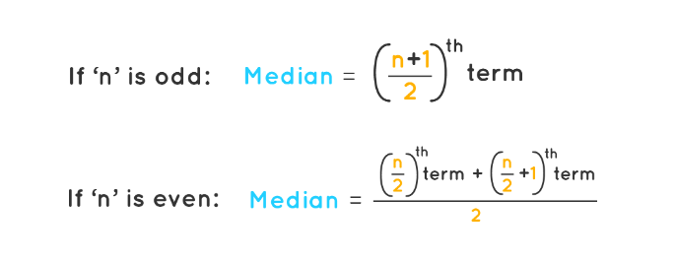
Median
How to find the Median:

Slide 29
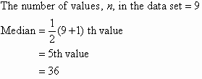
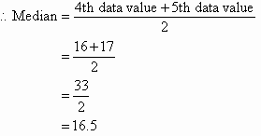
How to find the Median:
For Odd Number
For Even Number
Find the median of this set of data values.
47 35 37 32 38 39 36 34 35
Solution:
Lowest value to the highest value:
32 34 35 35 36 37 38 39 47
Find the median of the following data set:
12 18 16 21 10 13 17 19
Solution:
Arrange the data values in order from the lowest value to the highest value:
10 12 13 16 17 18 19 21
The number of values in the data set is 8, which is even.

Slide 30
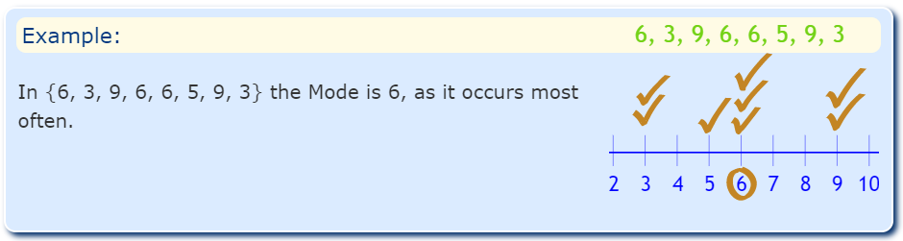
Mode(প্রচুরক )
The mode is the value that appears most frequently in a data set.

Slide 31
Mode(প্রচুরক )
Use
The mode represents the value(s) that occurs most often in a dataset.
The mode tells us the most common value in categorical data when the mean and median can’t be used.
Merits
It can be determined by observation
It is not affected by outliers
Also it can be used for the qualitative value
It can be presented graphically

Slide 32
Mode(প্রচুরক )
Limitations:
We cannot find the mode of the equal series
Mode may not be exist
Sometime there are more than one mode
Mode gives us an idea of where the “center” of a dataset is located, but it can be misleading compared to the mean or median.

Slide 33
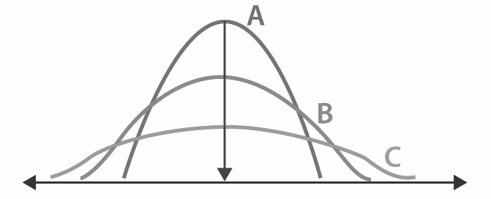
Measures of Dispersion
Literal meaning of dispersion is scatter ness. Dispersion is the degree of the scatter ness or deviation of each value in the data set from a measure of central tendency usually the mean.
The more similar the scores are to each other, the lower Measures of Dispersion will be
The less similar the scores are to each other, the higher Measures of Dispersion will be

Slide 34
Measures of Dispersion
Measures of Dispersion
Absolute Measure
Relative Measure
Range
Variance
Standard Deviation
Quartiles and Quartile Deviation
Co-efficient of Range
Co-efficient of Variation
Co-efficient of Standard Deviation
Co-efficient of Quartile Deviation

Slide 35
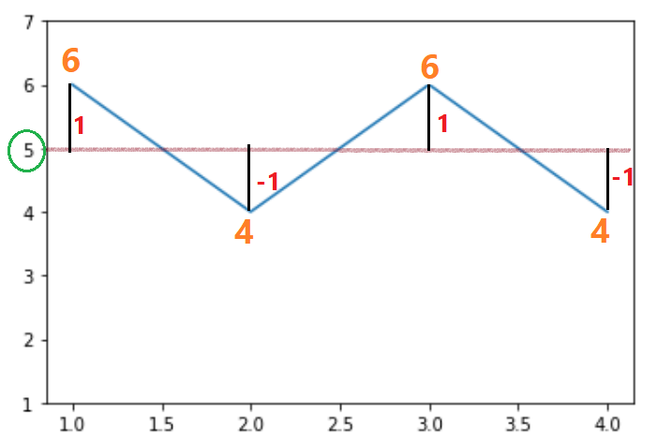
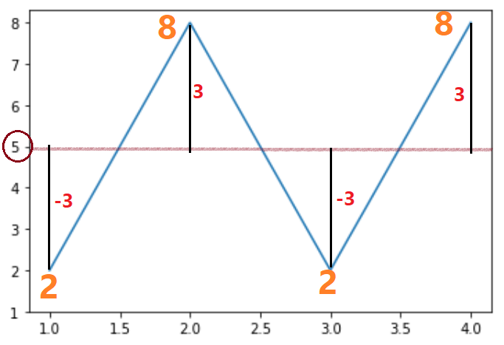
Variance
The variance is a measures that indicates how much data scatter around the mean.
6, 4, 6, 4
Mean = 5
2, 8, 2, 8
Mean = 5

Slide 36

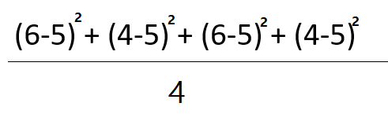
Variance
6, 4, 6, 4
Mean = 5
X
Total Distance = (6-5) + (4-5) + (6-5) + (4-5) = 0
Total Distance =
= 4
Variance =
= 1

Slide 37
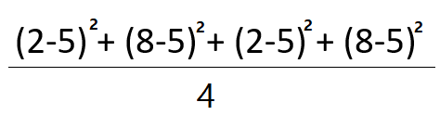
Variance
2, 8, 2, 8
Mean = 5
Variance =
= 9

Slide 38
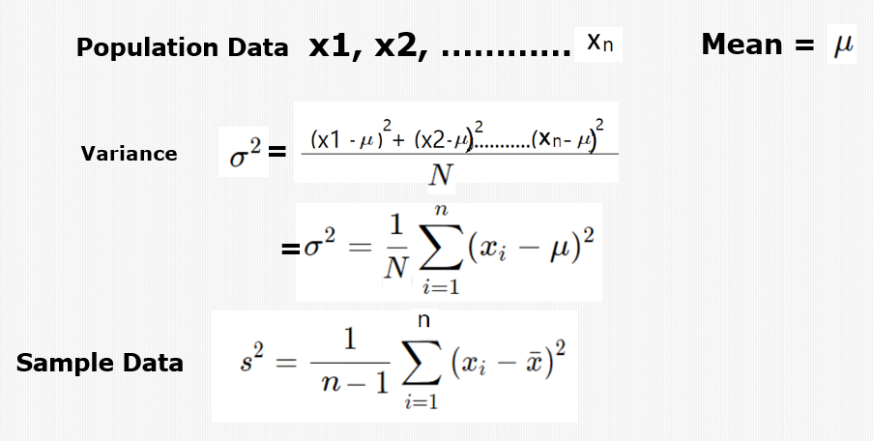
Variance

Slide 39
Standard Deviation (আদর্শ বিচ্যুতি )
(Mean)
Result
38 44 45 50 55 44 74
From which number we can say it is Good or Bad result ?
Mean plus or minus standard deviation is optimum result
but beyond this is either good or bad
Suppose SD = 2
Then optimum number is 50+2 = 52 or 50 -2 = 48

Slide 40
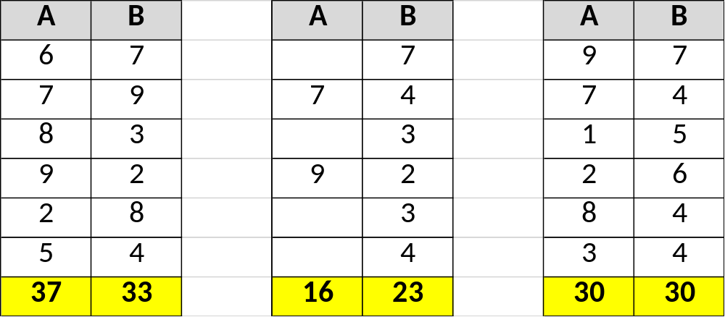
Standard Deviation (আদর্শ বিচ্যুতি )
Mean= 8 3.83

Slide 41
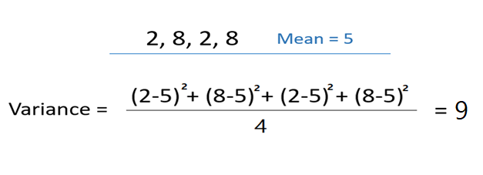

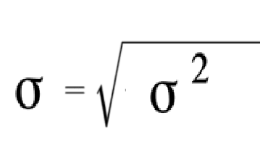
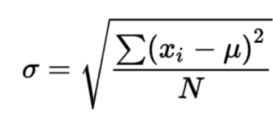
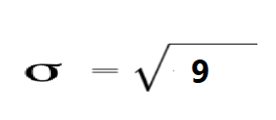
Standard Deviation (আদর্শ বিচ্যুতি )
How to calculate the Standard Deviation
= 3

